Slide 1



Music Machine Learning
XI – Adversarial learning
Master ATIAM - Informatique
Philippe Esling (esling@ircam.fr)
Maître de conférences – UPMC
Equipe représentations musicales (IRCAM, Paris)

Slide 2
Approximate inference
Probabilistic inference mostly deal with simple distributions
Provide easier analytical solutions
Implicit assumption of a simple explanation (capacity)
Too simplistic assumption in most cases
Real data follows largely more complex distributions
These distributions are usually intractable
The almighty Gaussian
Real data ?
Modelling complex distributions but keep analytical simplicity ?
Entering the magnificent world of approximate inference ♥︎
Either approximating statistics of the distribution
Sampling methods
Or optimizing simpler distributions to fit the true one
Variational inference
Normalizing flows
Adversarial learning

Slide 3
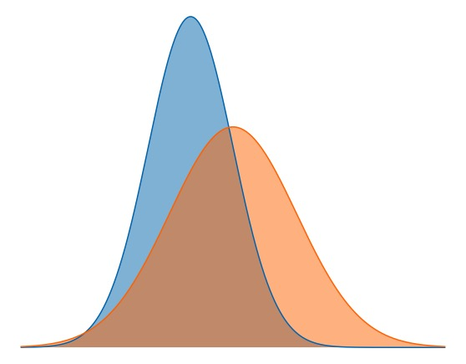
Learning by comparison
For our models, we only have access to
Unnormalized probability observation
Partial knowledge of the distribution
Can we define a simulator of data
How to compare the estimated distribution to the true distribution using only samples

Slide 4
Learning by comparison
Density estimation by comparison
Probability difference
Probability ratio
Maximum Mean Discrepancy
Moment matching
Bregman Divergence
Class probability estimation
f-Divergence
Use a hypothesis test or comparison to build an auxiliary model to indicate how data simulated from the model differs from observed data
Adjust parameters to match the data distribution by comparison

Slide 5
Density ratios and classification
Density ratio
Bayes’ rule
We have real data samples
And simulated data samples that should ressemble real
1. Combine data
2. Assign labels
Equivalence
Real data
Simulated data

Slide 6
Density ratios and classification
Based on our equivalence
If we develop the density ratio, we obtain
So, finally we have a simple equivalence
Our density estimation reduces to a classification task

Slide 7
Unsupervised-as-supervised learning
With a 2-class problem, we have a simple scoring function
We can define this as a Bernoulli loss
So we need an alternate optimisation
Minimize the number of examples classified as fake
(improve our generation)
Maximize the quality of our discrimination
(improve our classification)
Paradoxical ?

Slide 8
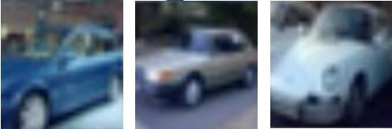
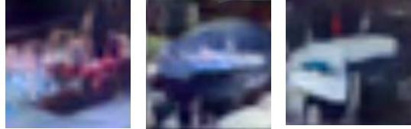
Generative Adversarial Networks (GAN)
Noise
Generative network
Real images
Fake images
Discriminator network
Real
Fake
Alternating optimisation
Comparison loss
Generator loss

Slide 9
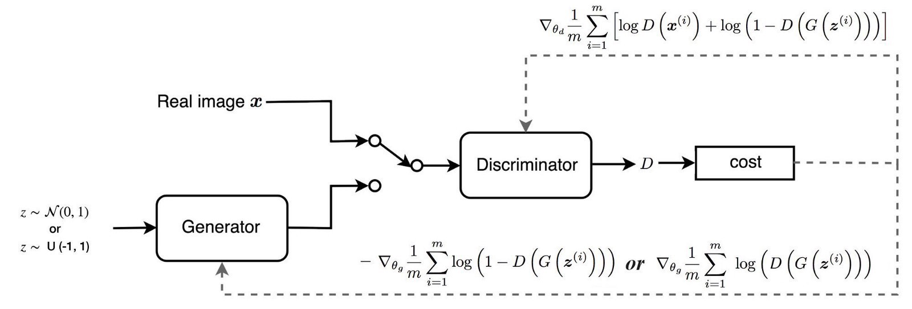
Generative Adversarial Networks (GAN)
Can be linked to game theory (jeu minimax à 2 joueurs)
Generator tries to create outputs that ressemble real data
Discriminator tries to recognize them
Zero-sum game

Slide 10
Understanding the GAN loss
The discriminator D tries to maximize the discrimination
Changing his weights to better separate fake from real
1
0
real data
fake data
The generator G tries to minimize the discrimination
Generating better examples to confound the classification
0
1
real data
fake data
Alternating and competing objectives

Slide 11
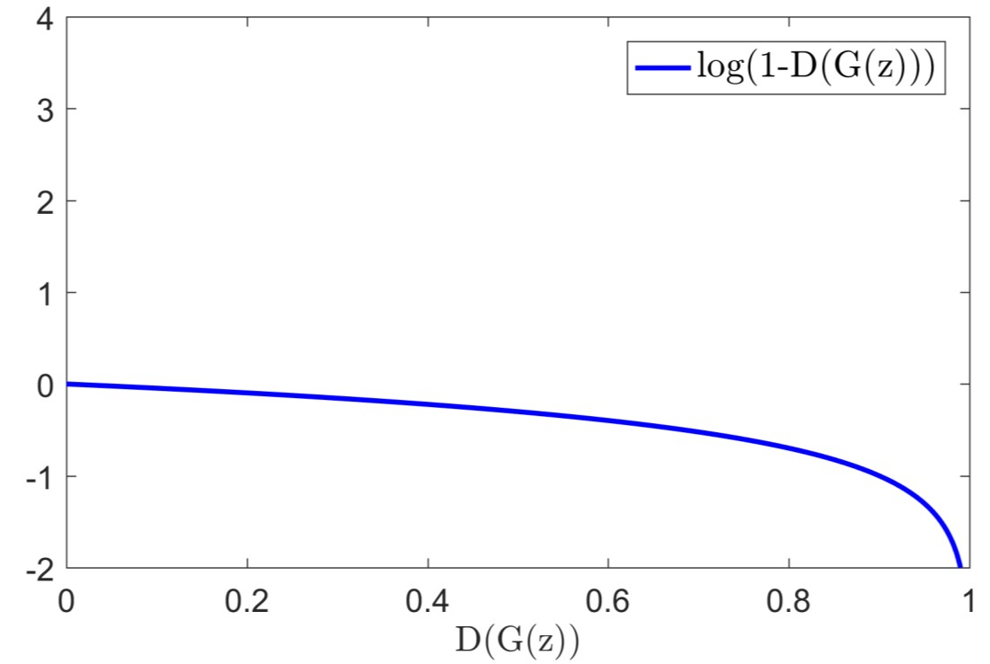
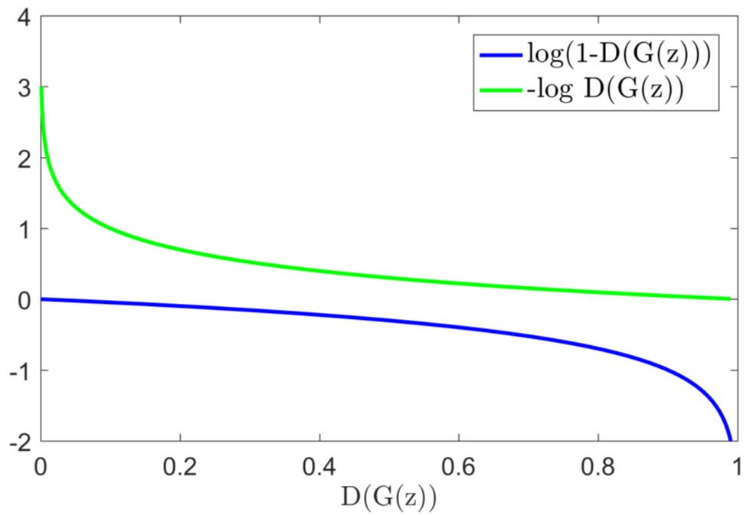
Training the GAN
Objective function to optimize
Alternating between
– Gradient ascent for the discriminator
– Gradient descent for the generator
Gradient stronger where it matters
Weak gradient when the discriminator is too strong
Good but useless gradient when the generator is too strong

Slide 12
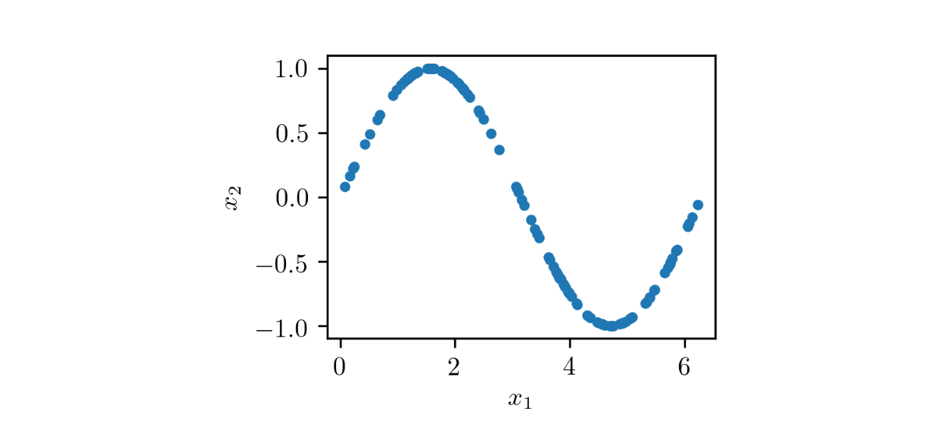
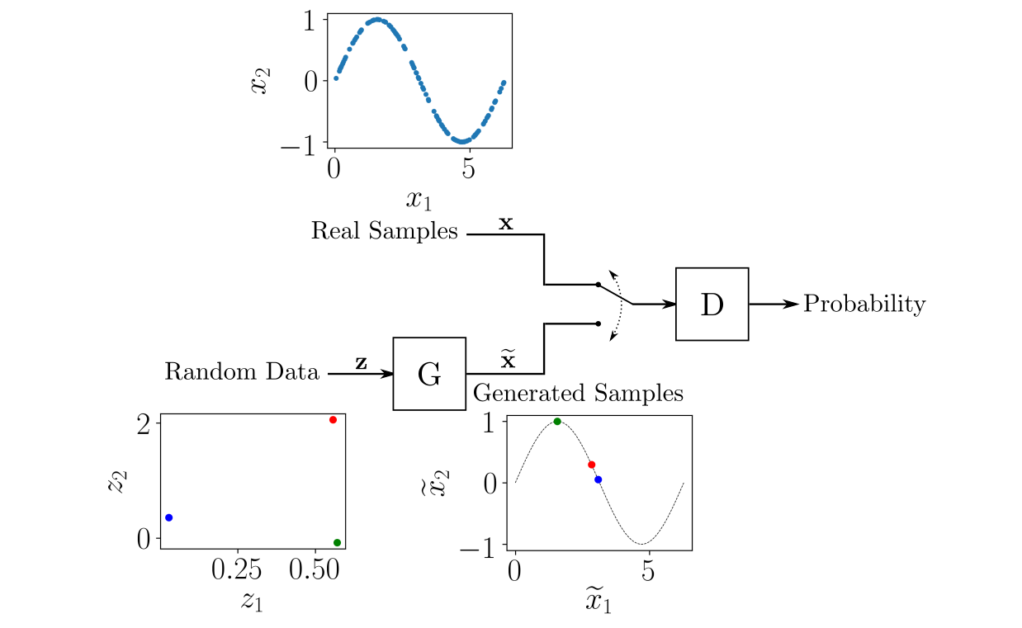
Practical toy example
Here we show a worked out toy example (cf. notebook)
Imagine we want to optimize a sinus distribution
The generator draws random samples
Tries to optimize the function to ressemble a sinus

Slide 13
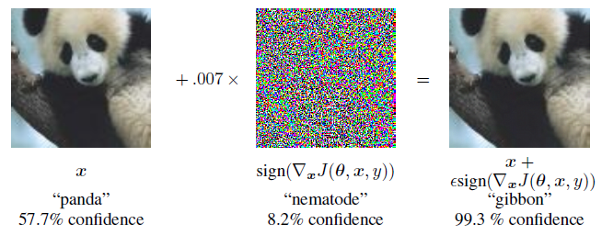
Another application of adversarial
Szegedy et al. (2014b) - Vulnerability of machine learning models to adversarial examples
Adding a small amount of structured (learned) noise
Leads to very large error rates (with large confidence on errors)
Seems to apply to any type of model
We can directly add adversarial examples in training
Adversarial objective function with the fast gradient sign method

Slide 14
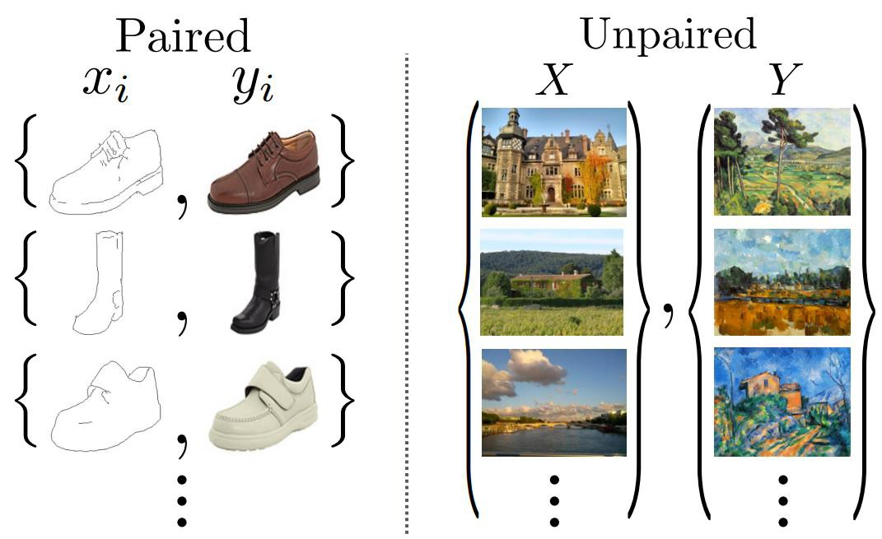
CycleGAN: weakly supervised cycle loss
Training pairs might be weakly linked

Slide 15
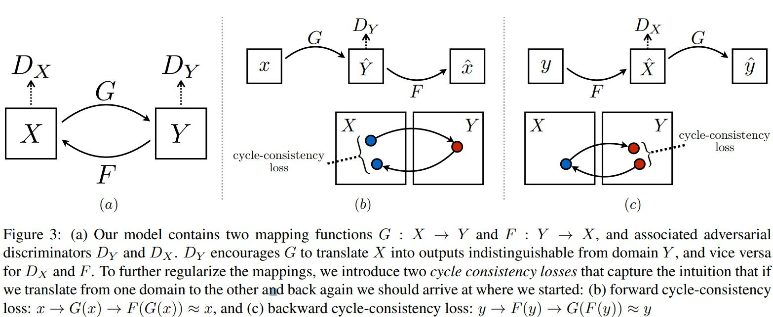
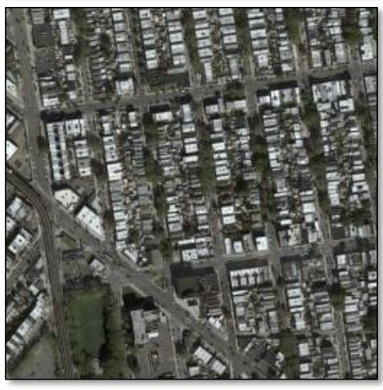
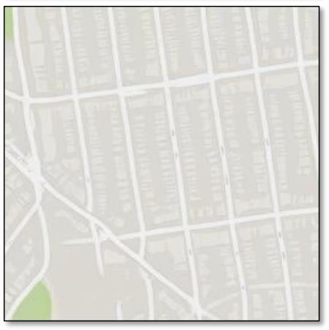
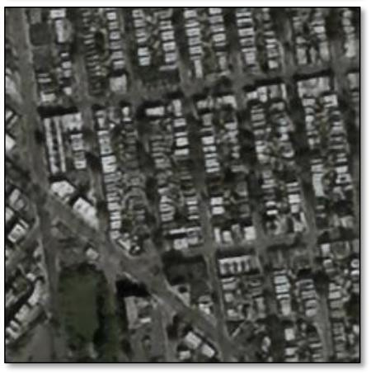
CycleGAN: weakly supervised cycle loss
28
G(x)
F (G(x))
x

Slide 16
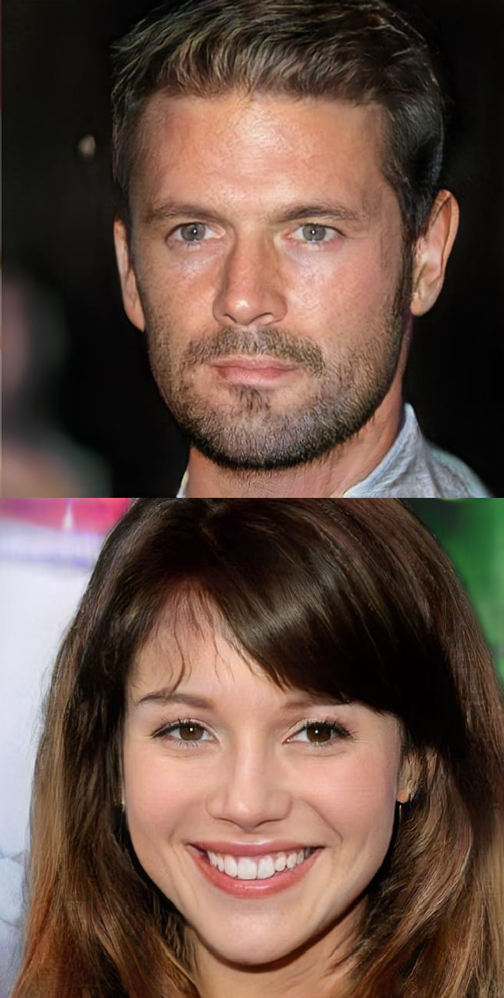
Progressive growing of GANs
Looking to
Stabilize the training of GANs
Increase the output quality
Output images of 1024x1024
Key ideas
Need to gradually increase image size
Start by highly quantified images
Use these as conditioning
Add a heuristic for diversity
29
Karras et al., Progressive Growing of GANs for Improved Quality, Stability, and Variation, ICLR 2018.

Slide 17
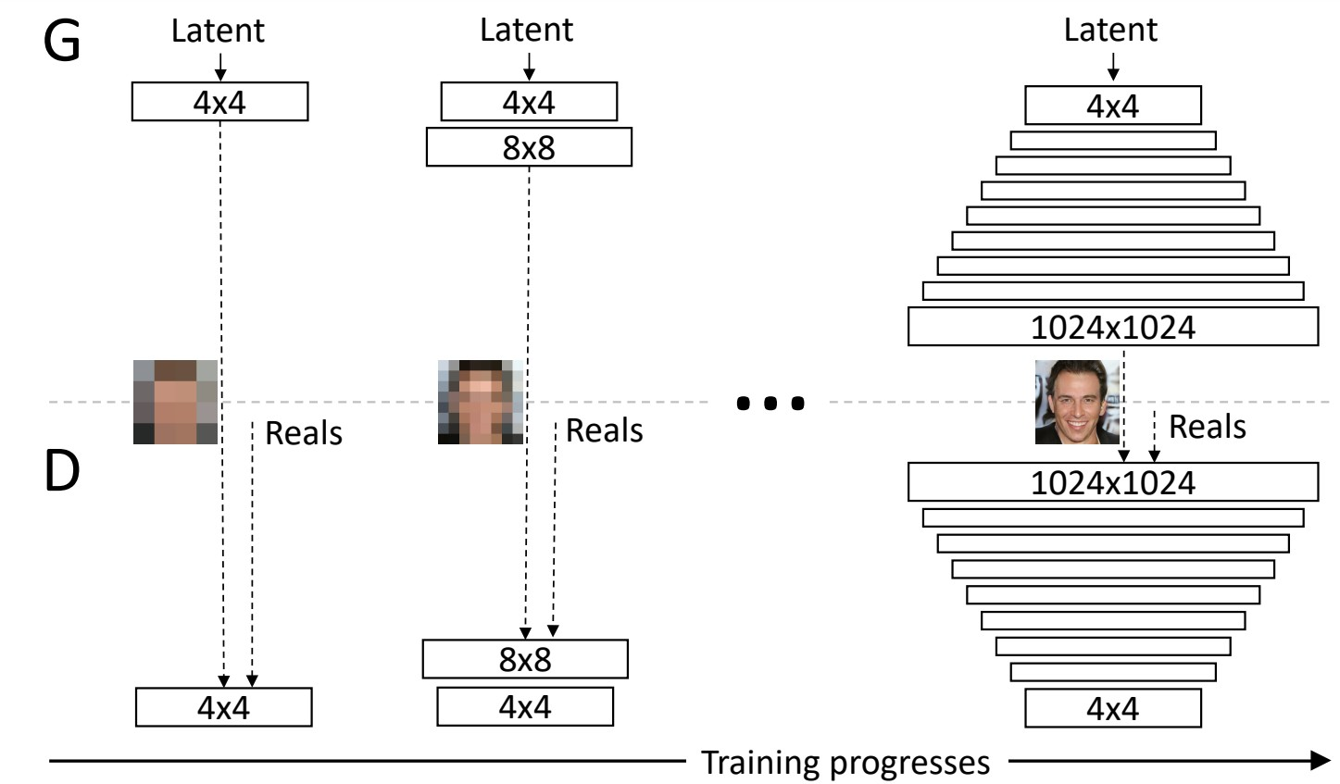
Progressive growing of GANs
Progressively increase the size of generation
And consequently the size of the generator
Allows the network to discover large-scale structures
Then refines the image details
Faster, as it trains on smaller images
Note : finer details are more complicated for GANs

Slide 18
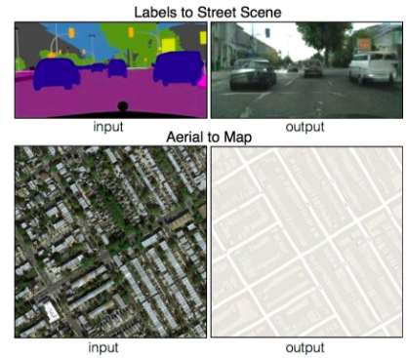
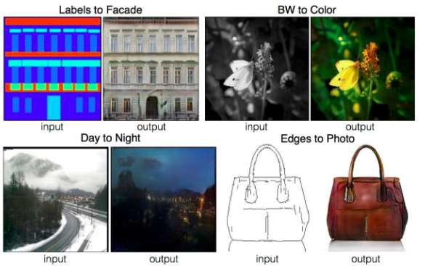
Pix2Pix
Demo : https://affinelayer.com/pixsrv/

Slide 19
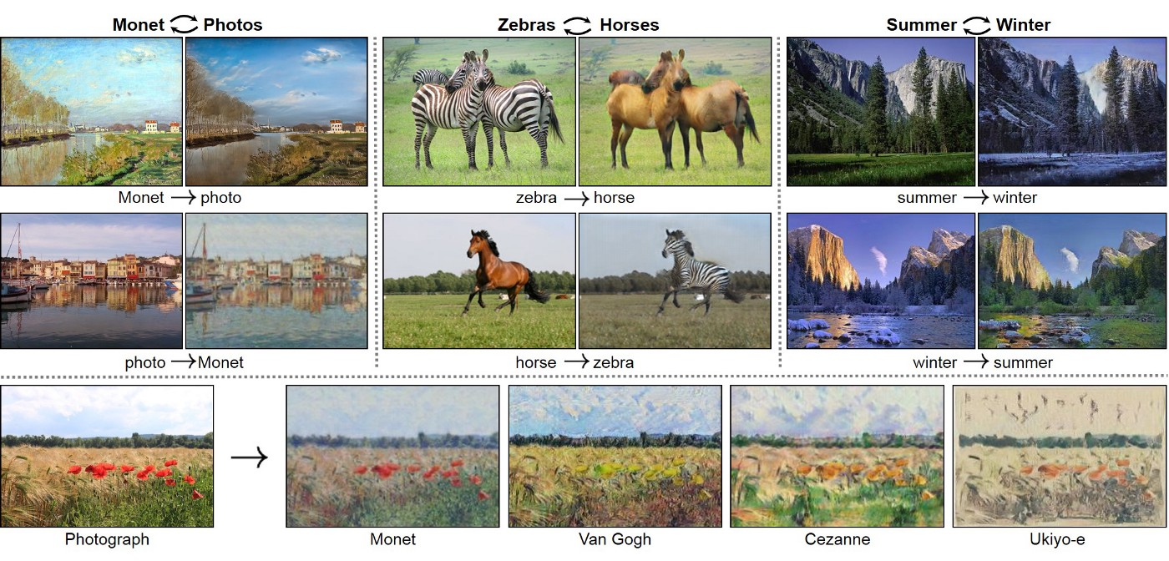
GANs in action – style transfer
https://medium.com/ai-society/gans-from-scratch-1-a-deep-introduction-with-code-in-pytorch-and-tensorflow-cb03cdcdba0f

Slide 20
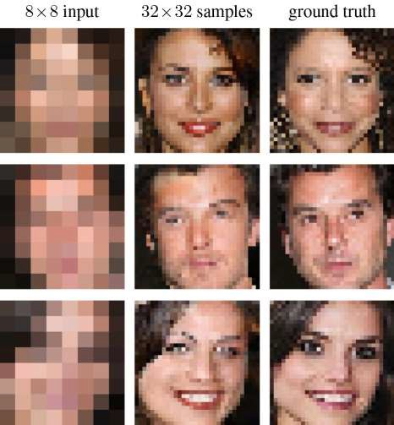
Super-resolution

Slide 21
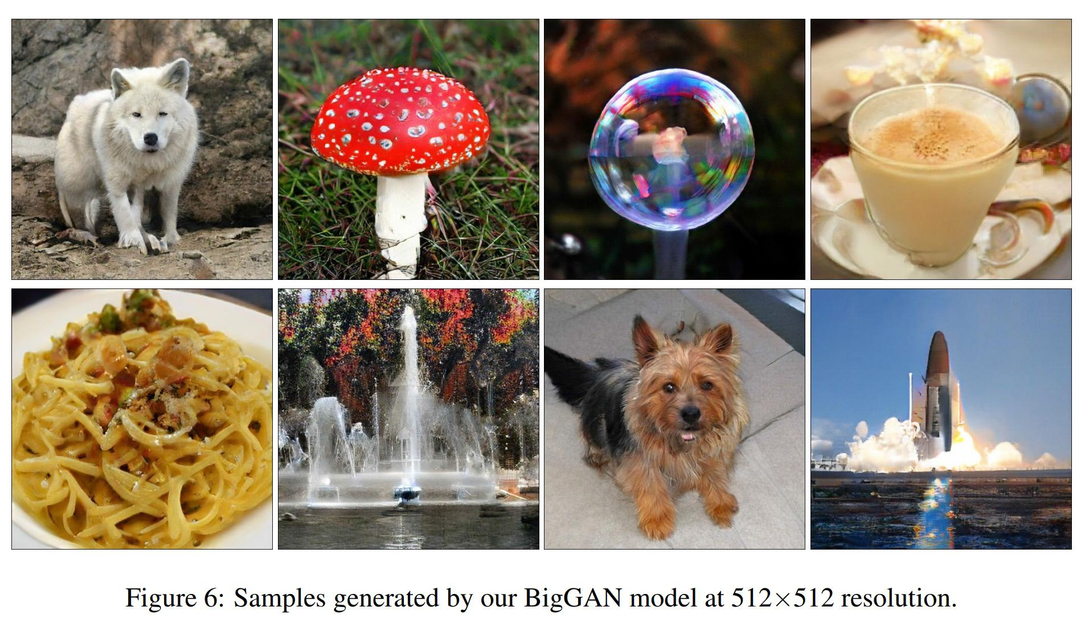
Nowadays generation quality (2019)
Large Scale GAN Training for High Fidelity Natural Image Synthesis,
https://arxiv.org/abs/1809.11096

Slide 22
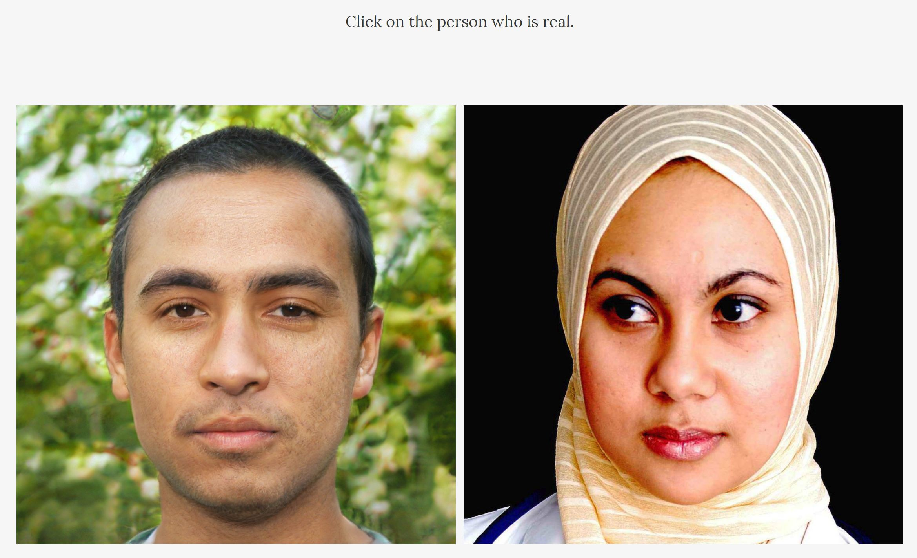
Hard to distinguish false from real
http://www.whichfaceisreal.com/index.php

